Slide 1
Understanding Edge-of-Stability Training Dynamics with a Minimalist Example
Zixuan Wang

Slide 2
Outline
Gradient descent, L-smoothness and sharpness
The Edge-of-Stability phenomenon
Our minimalist model with EoS + Trajectory analysis
Experiments + Discussions

Slide 3
Outline
Gradient descent, L-smoothness and sharpness
The Edge-of-Stability phenomenon
Our minimalist model with EoS + Trajectory analysis
Experiments + Discussions

Slide 4
Machine learning and Gradient Descent
There are millions of ML problems/target functions
But (almost) just one algorithm for optimization:
(Stochastic) Gradient Descent or its variants.
Not because ML researchers are lazy/stupid!
--- It’s actually powerful and widely-used.
[Machine Learning slides, Prof. Yang Yuan]

Slide 5
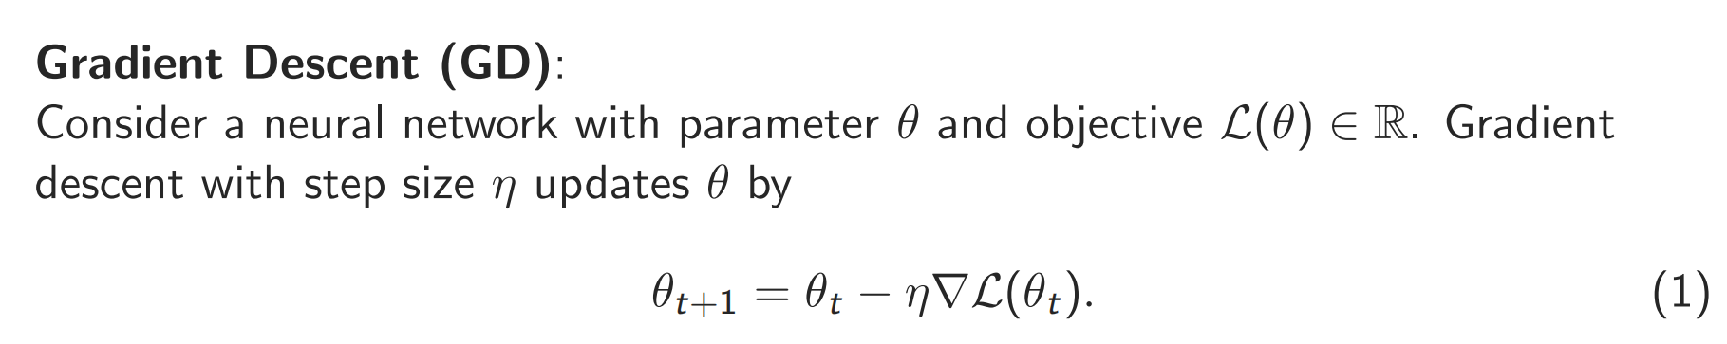
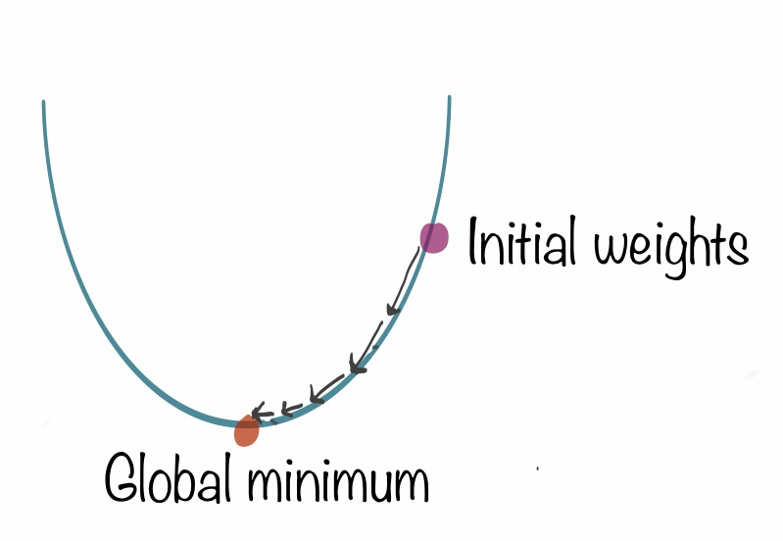
Gradient Descent
Intuition:
Gradient gives the direction to decrease the loss function objective.
Take one step of that direction and do this iteratively (gradient direction may change over time)
[Machine Learning slides, Prof. Yang Yuan]

Slide 6
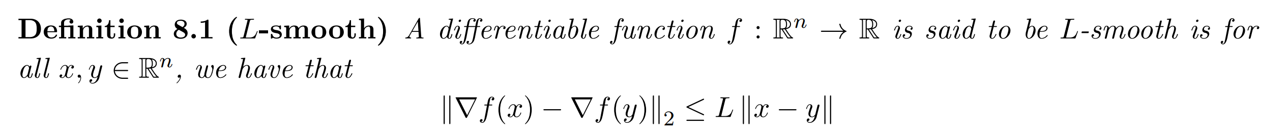
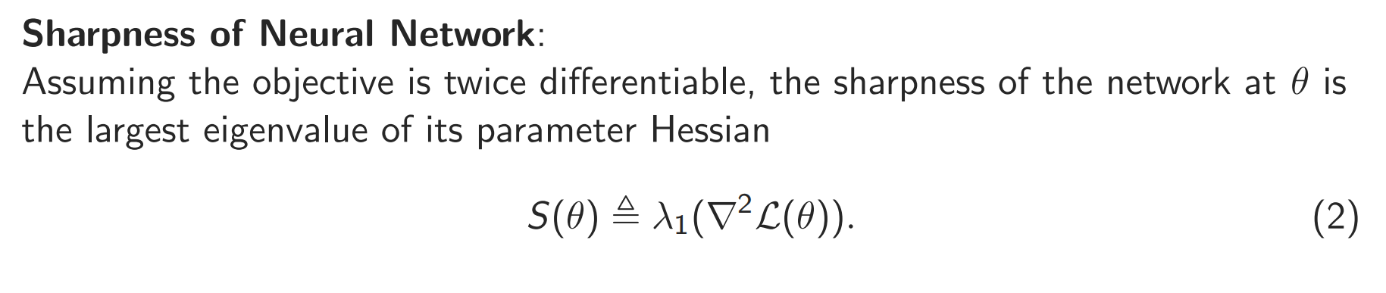
L-smoothness and sharpness
[cme323_lec8.pdf (stanford.edu)]
The L-smoothness assumption: the gradient cannot change too quickly.
L-smoothness assumption: sharpness is always upper-bounded by L !

Slide 7
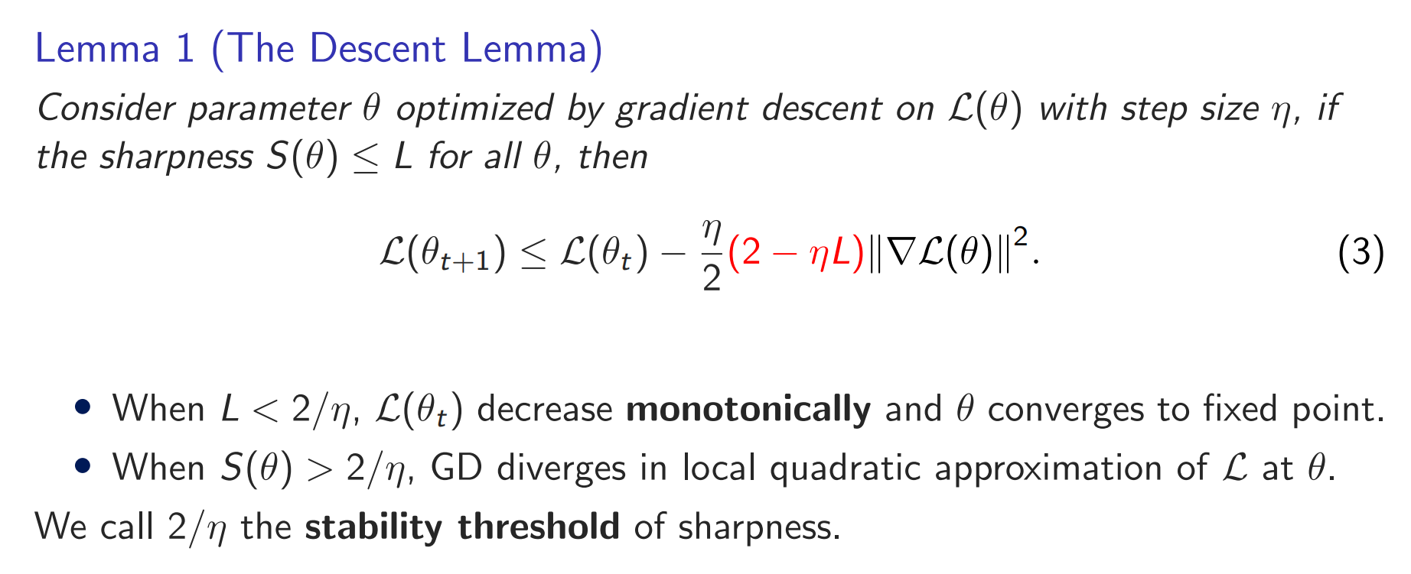

Descent Lemma
We should pick the step size $η<\frac{2}{L}$ to make sure the loss decreases.
But is it always True…?

Slide 8
Outline
Gradient descent, L-smoothness and sharpness
The Edge-of-Stability phenomenon
Our minimalist model with EoS + Trajectory analysis
Experiments + Discussions

Slide 9
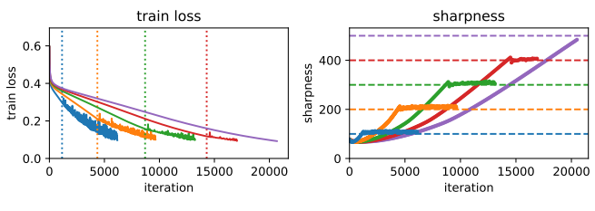
Progressive sharpening and Edge of Stability
The descent lemma does not always hold!
Cohen et al. observe that:
(Progressive sharpening) The sharpness first increases until it reaches 2/η.
(Edge of Stability, EoS) The sharpness starts hovering around 2/η.
The loss non-monotonically decreases without diverging.
This regime cannot be explained by traditional analysis!
[Cohen et al. ICLR 21]

Slide 10
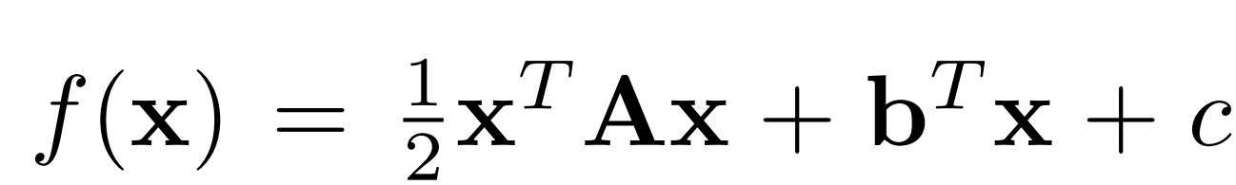
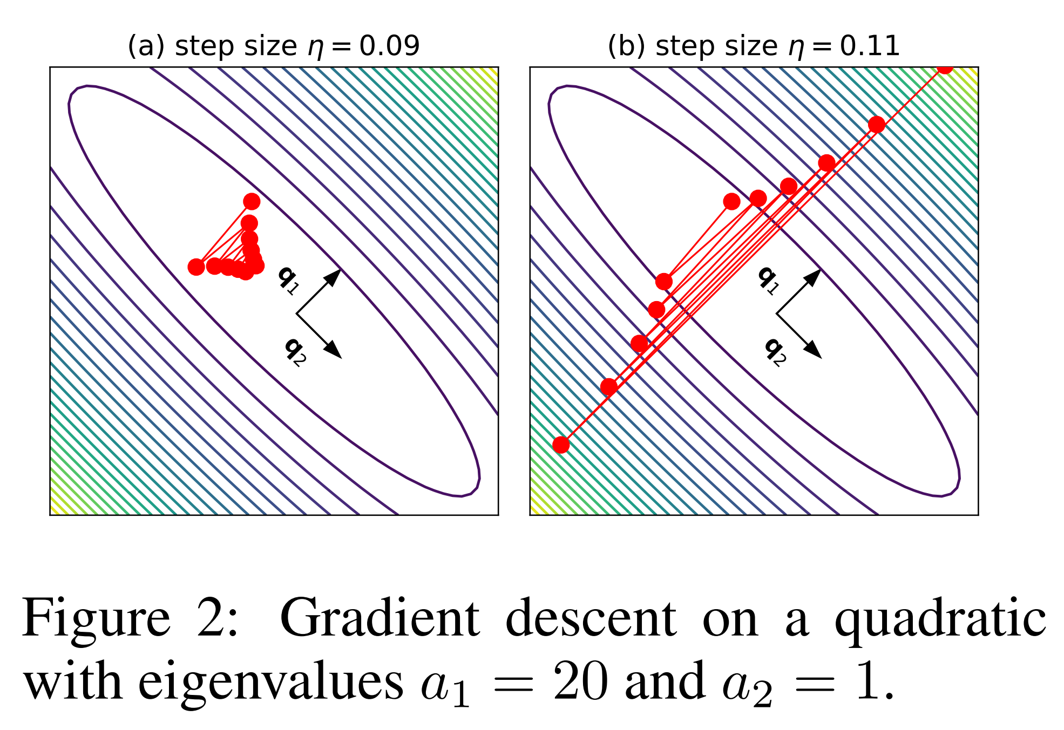
EoS: Neural networks are not quadratic!
On a quadratic objective:
Once sharpness grows larger than 2/η, the top eigendirection diverges!
GD also diverges on a fixed local quadratic approximation.
[Cohen et al. ICLR 21]

Slide 11
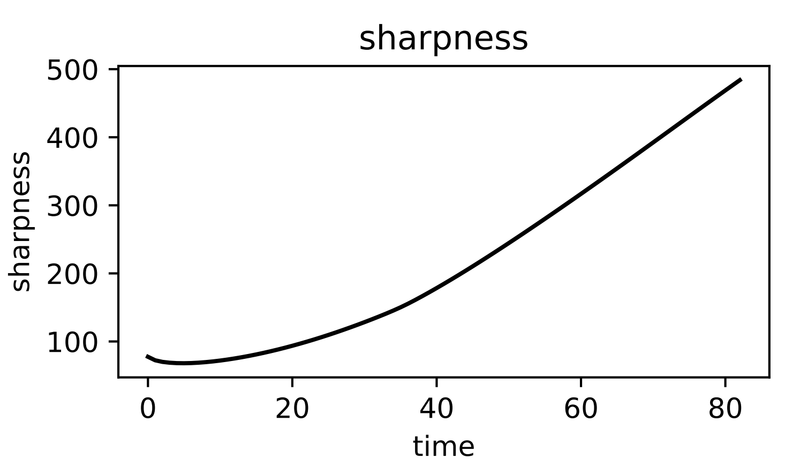
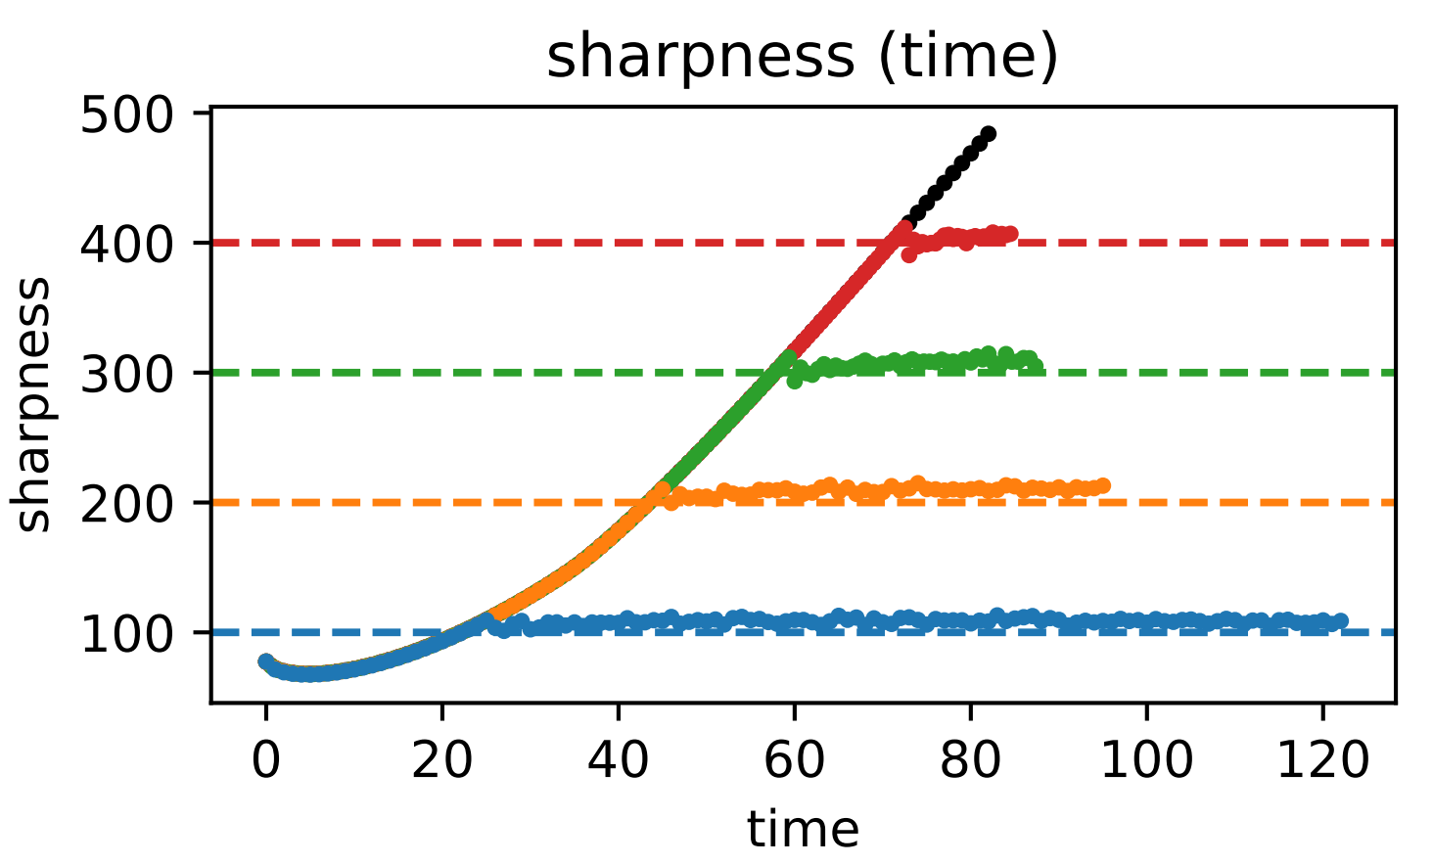
Gradient descent and gradient flow
Gradient flow:
Sharpness keeps increasing
Gradient descent:
Sharpness increases to the stability threshold and oscillates around it (???)
Eventually converge to a minimum with sharpness ≈ 2/η.
Beyond the NTK regime:
Always requires the sharpness smaller than 1/η.
[Cohen et al. ICLR 21]

Slide 12
What is interesting about EoS?
Convergence cannot be explained by traditional analysis
Diverging in quadratic approximation vs converging in real landscape
Monotonic vs non-monotonic decreasing of loss
Step size determines converging sharpness
Gradient descent V.S. gradient flow trajectory (out of the NTK regime)
Implicit regularization effect of learning rate - better generalization (Keskar et al., 2016; Jiang et al., 2019) ?

Slide 13
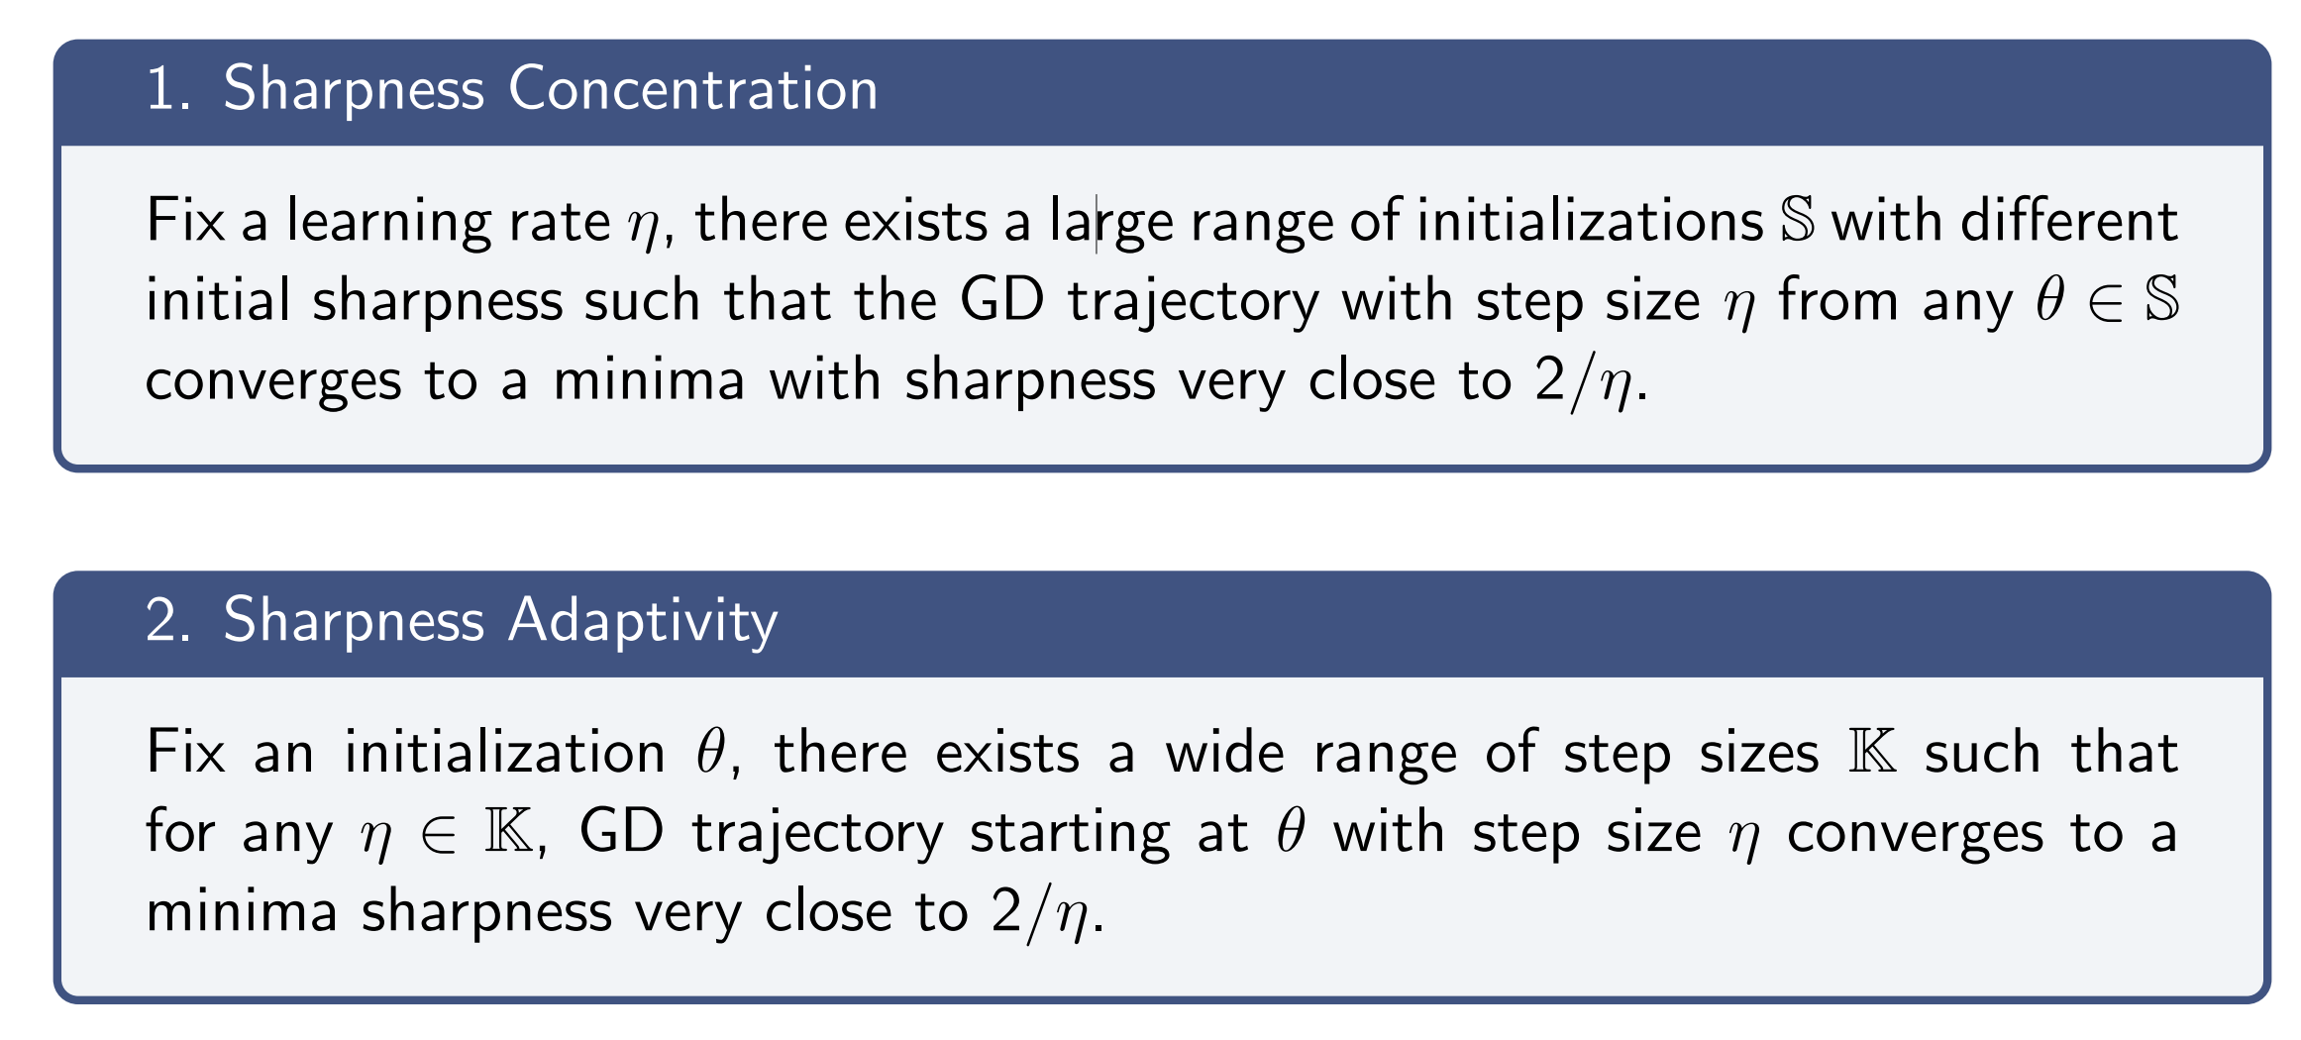
Characterization of Edge-of-Stability

Slide 14
Outline
Gradient descent, L-smoothness and sharpness
The Edge-of-Stability phenomenon
Our minimalist model with EoS + Trajectory analysis
Experiments + Discussions

Slide 15
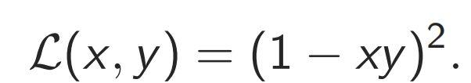
Minimalist Example for EoS
To explore this problem by the first principle, we try to find the simplest model that Edge-of-Stability can happen.
Scalar network!
Let’s first consider a two-scalar product:
Previously, Wang et al. (2022) and Chen and Bruna (2022) has conducted fine-grained convergence analysis for this model.
But the converging minima are significant flatter than 2/η.
Do not satisfy the sharpness concentration!
Later we will discuss why…

Slide 16
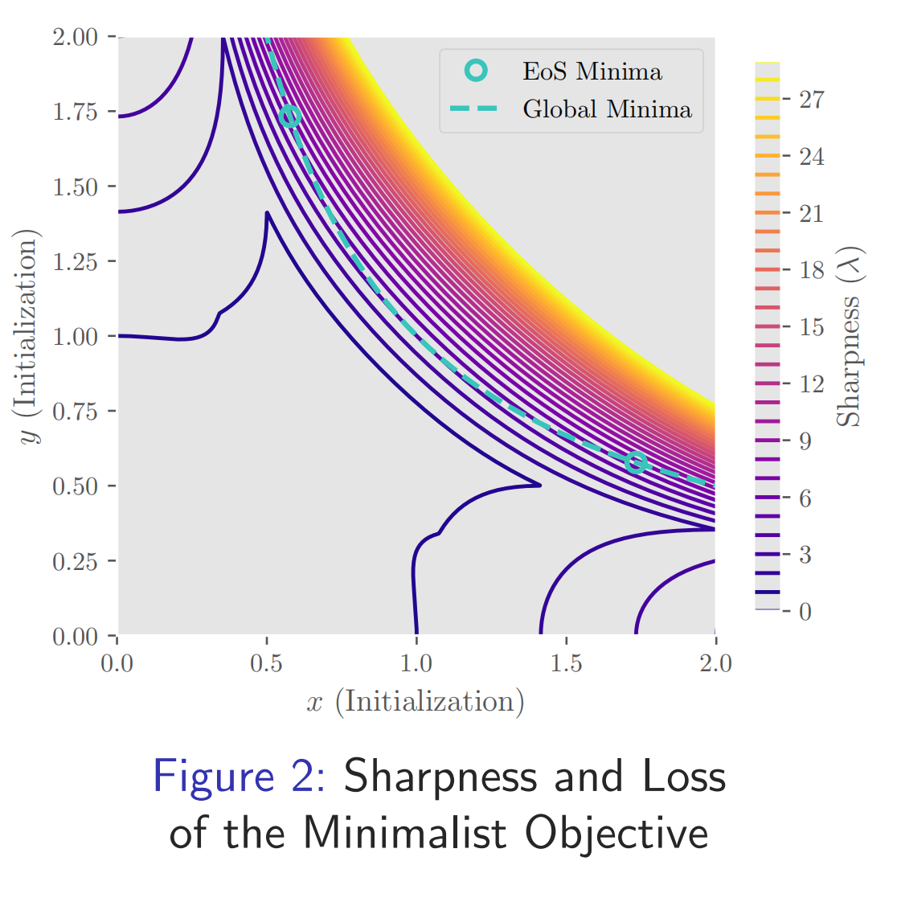
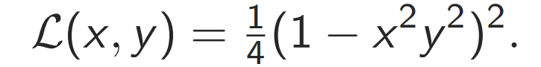
Minimalist Example for EoS
Unfortunately, 2 scalar fails—we need more!
Consider the simple objective:
It is equivalent to a 4-scalar network with initialization (x, x, y, y) and input (1, 1).
Let’s see the loss plot & sharpness contour:
Global minima xy = 1.
(In the first quadrant) 2 EoS Minima
EoS Minima: minima with sharpness = 2/η.

Slide 17
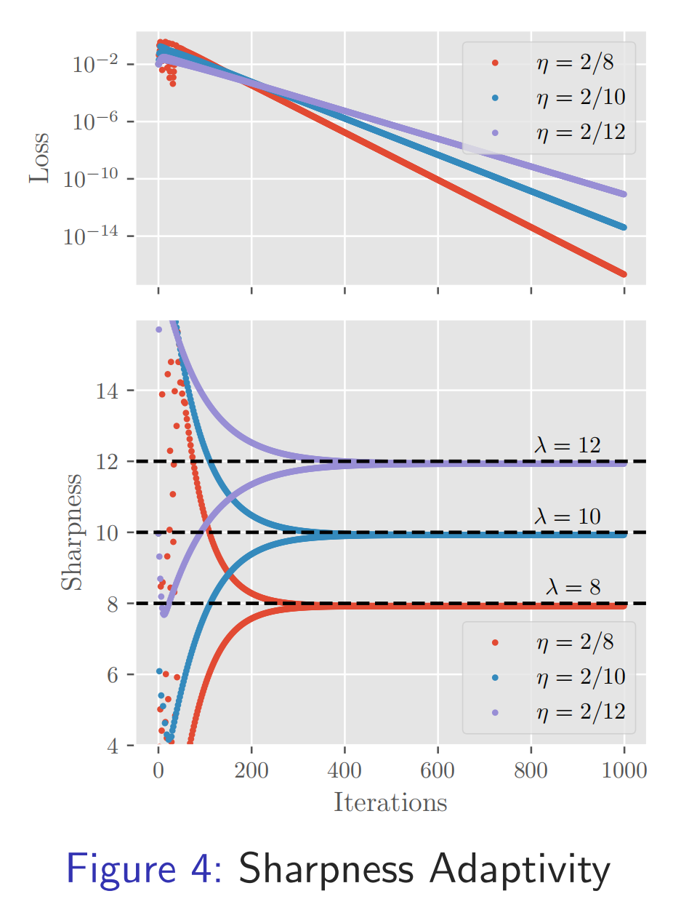
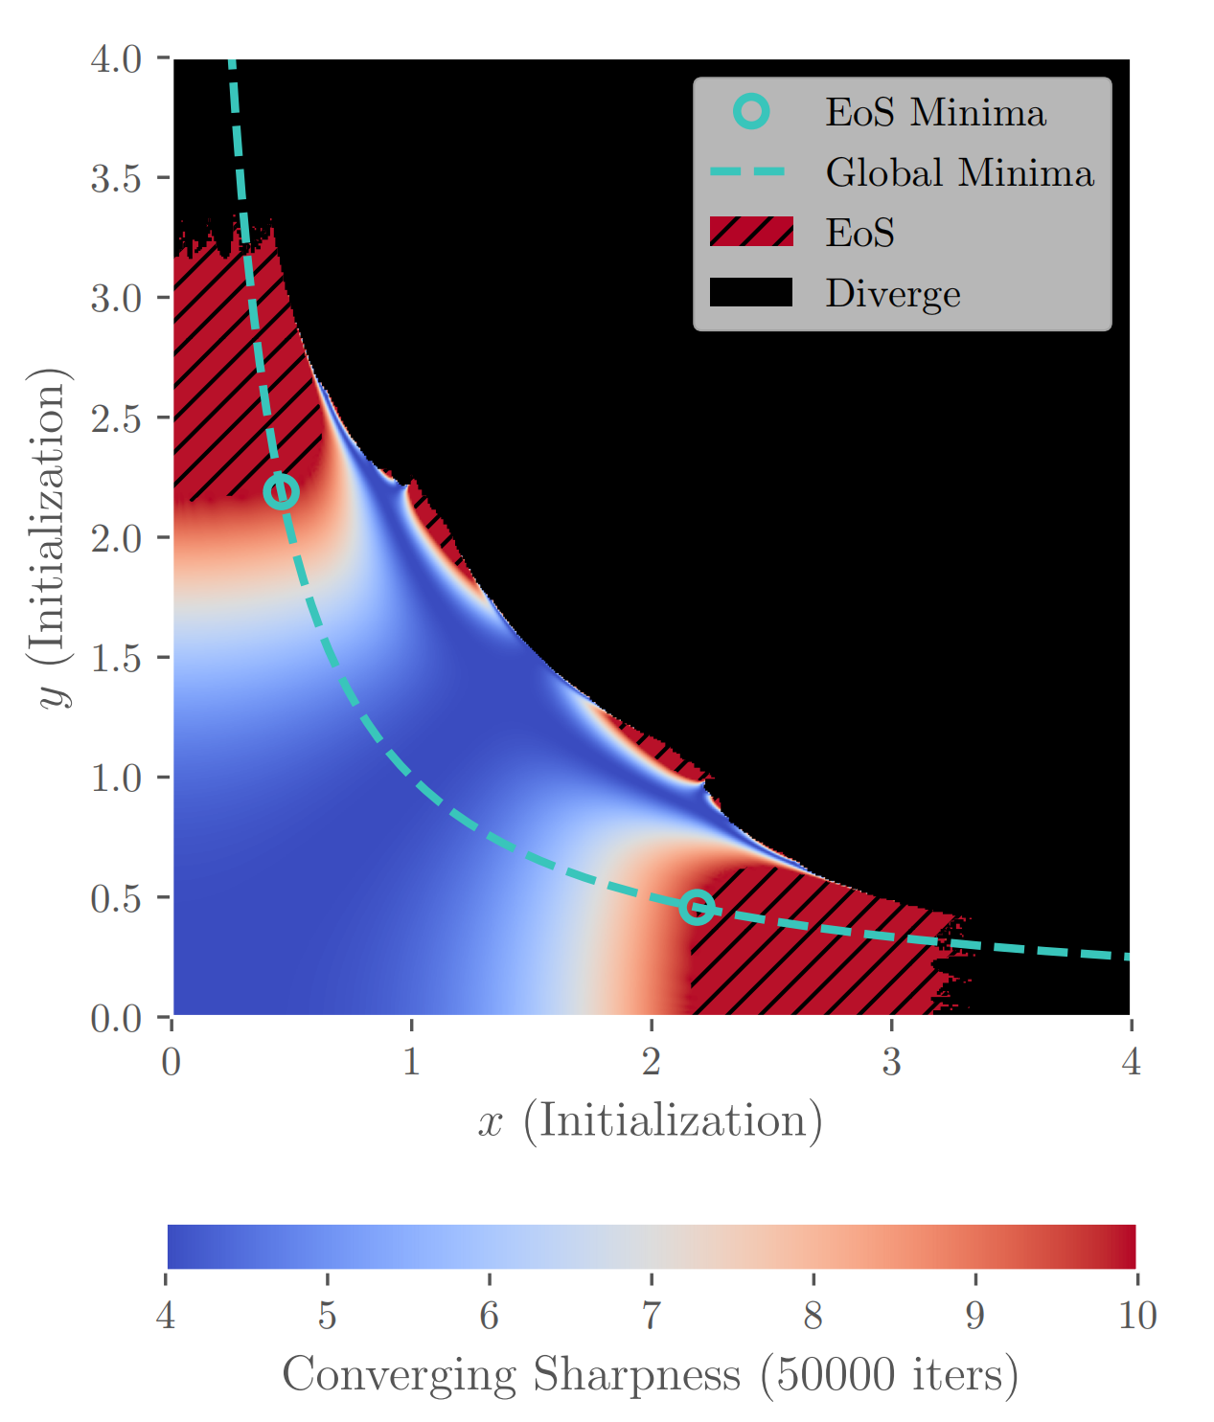
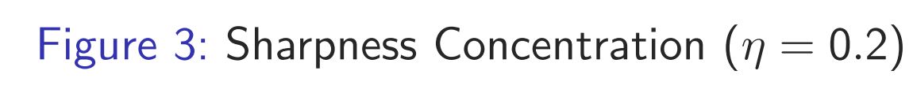
Sharpness Concentration and Adaptivity
Surprisingly, the simple objective exhibits both sharpness concentration and adaptivity!

Slide 18
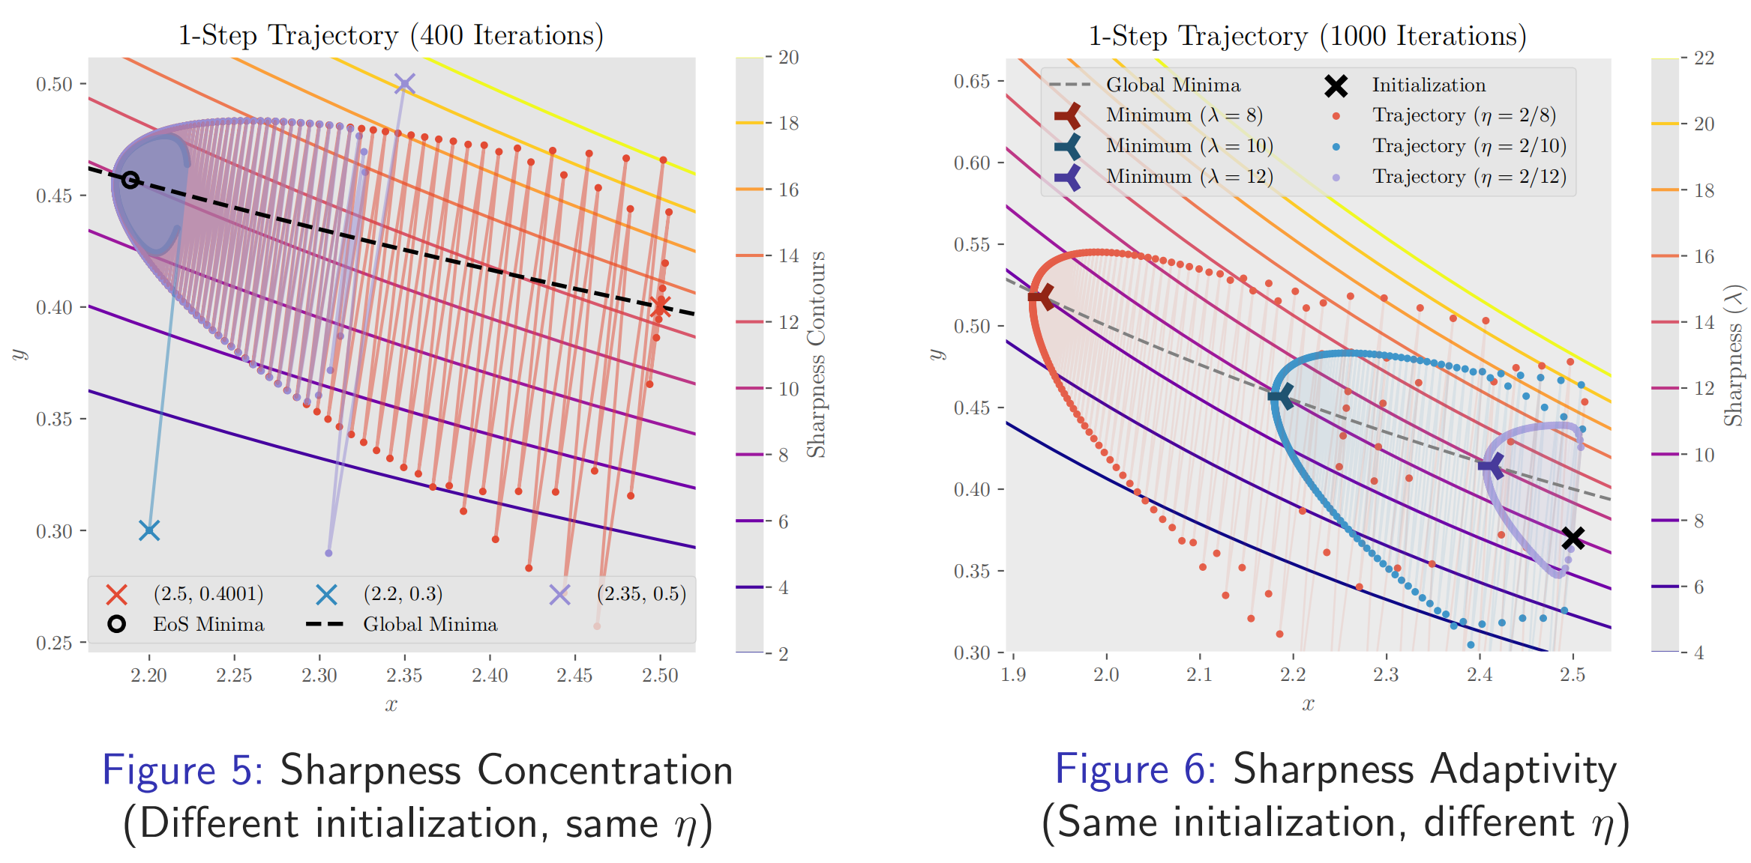
Training Trajectory of GD
Why there exist these two characterization?
Fortunately, we can plot the GD trajectory:

Slide 19
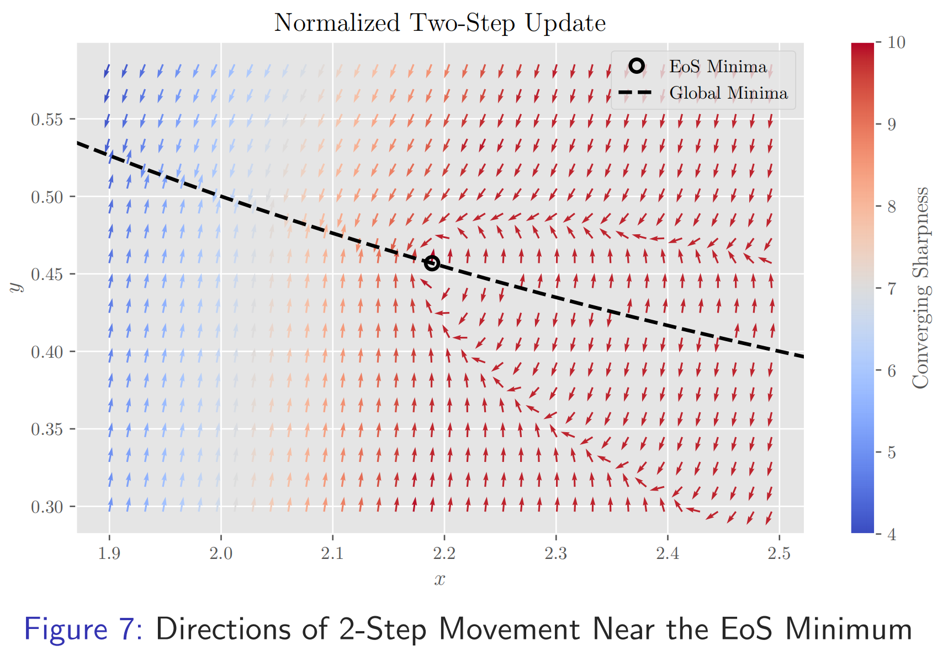
EoS Trajectory—the parabolic boundary
What is the trajectory’s boundary?
Look like a parabola with the tip near the EoS minima (determined by the step size η)!
The phase portrait shows the similar result:
There must be some reason lying in the GD dynamics!!
Though the parabola is kind of tilted…(Remember this issue)

Slide 20
Dynamics characterization
GD update on (x, y):
The vertex of the parabola is approximately the η-EoS minimum!
Local dynamics should be enough to capture this!
We consider the local taylor expansion around this minimum.
But…is (x, y) coordinate the best parameterization?
The parabola is tilted (along the xy=1), so….

Slide 21
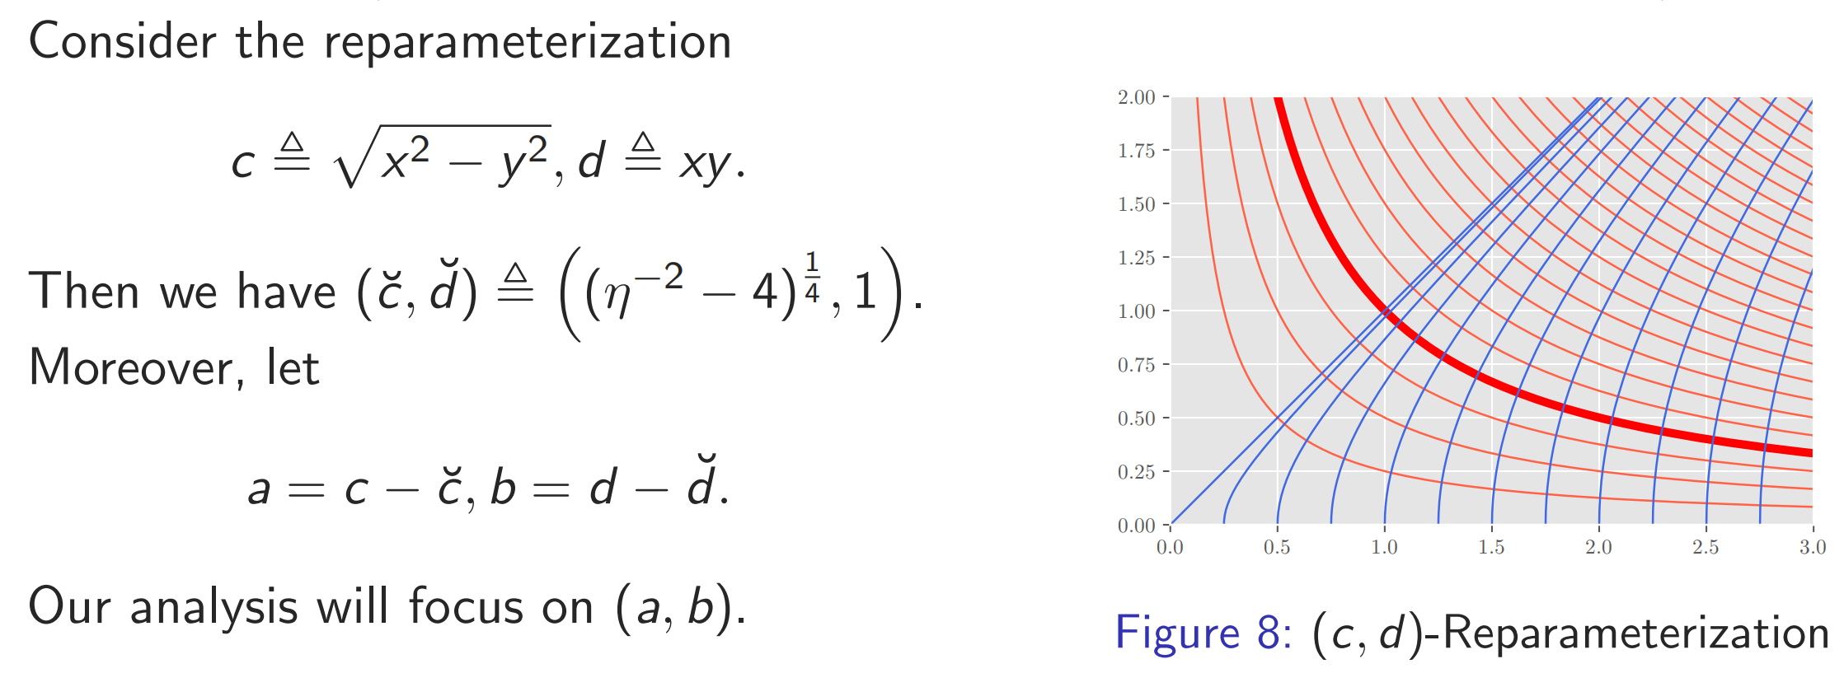
Reparameterization

Slide 22
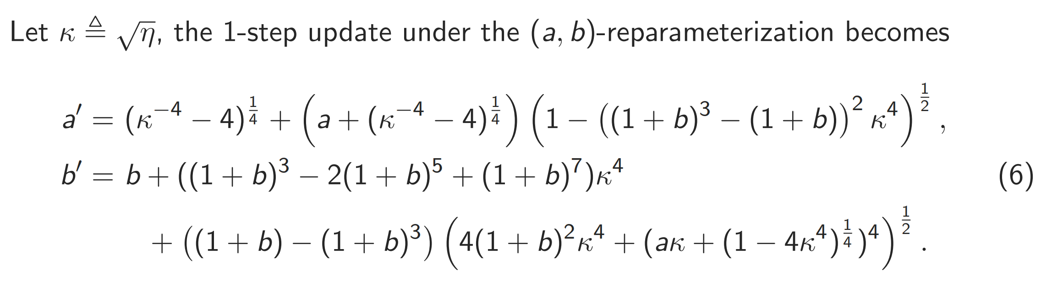
New dynamics characterization
From (x, y) to (a, b):
Oh no too complicated!
Don’t worry, we can use Taylor expansion

Slide 23
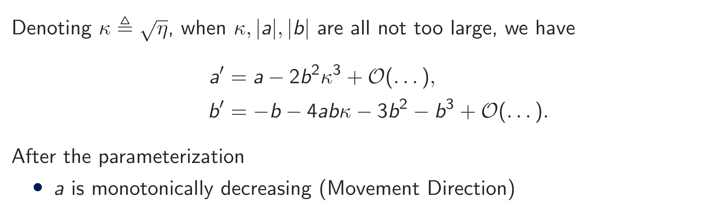

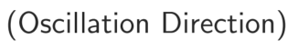
Approximate 1-step dynamics

Slide 24
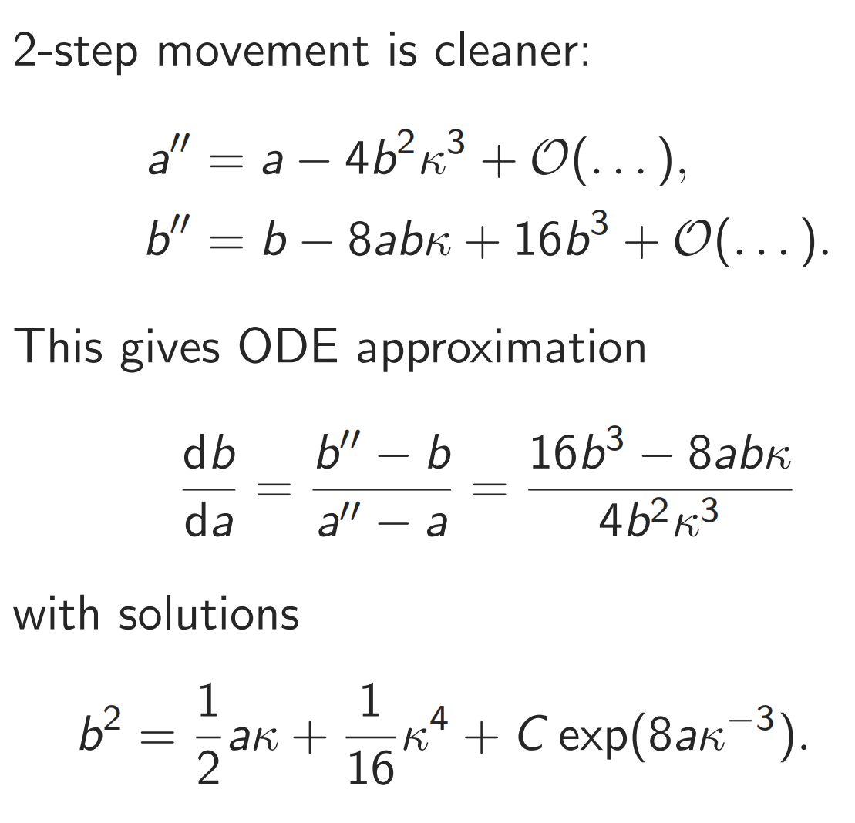
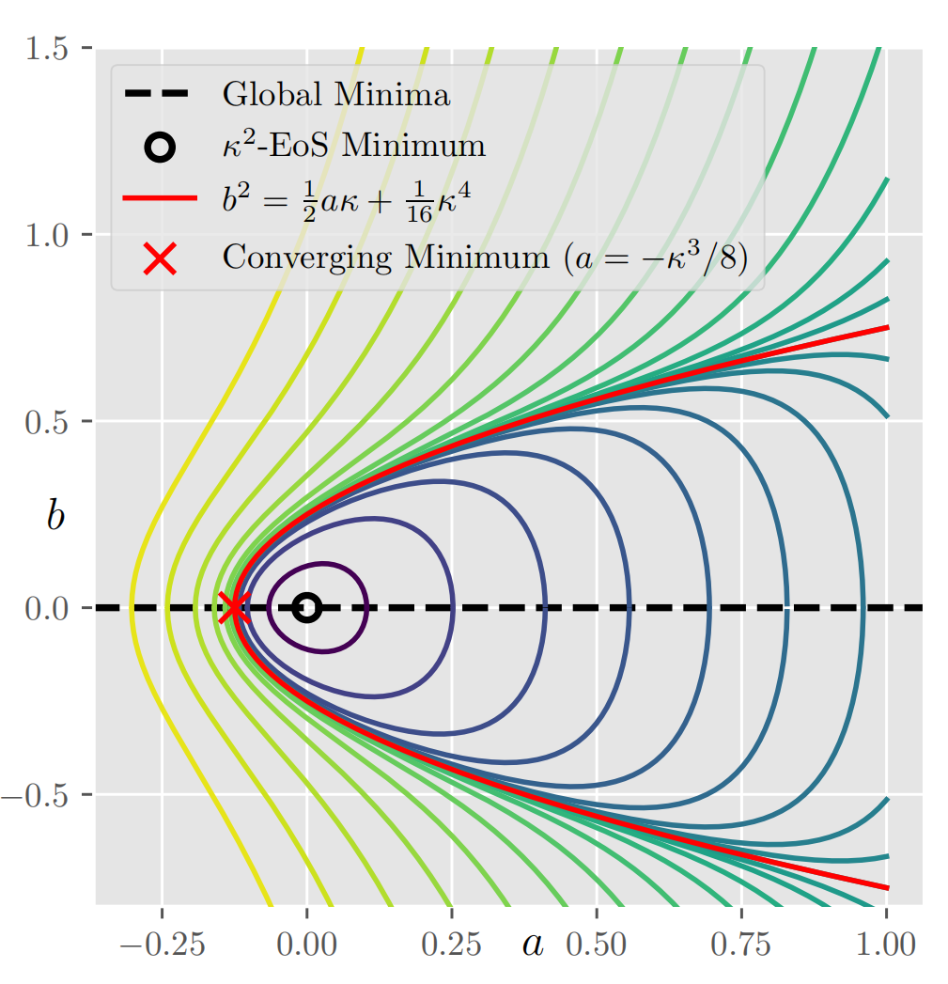
Approximate 2-step dynamics
Why b’ is always flipping signs without much movement:
Some terms cancel out in two steps—look at the 2-step dynamics!

Slide 25
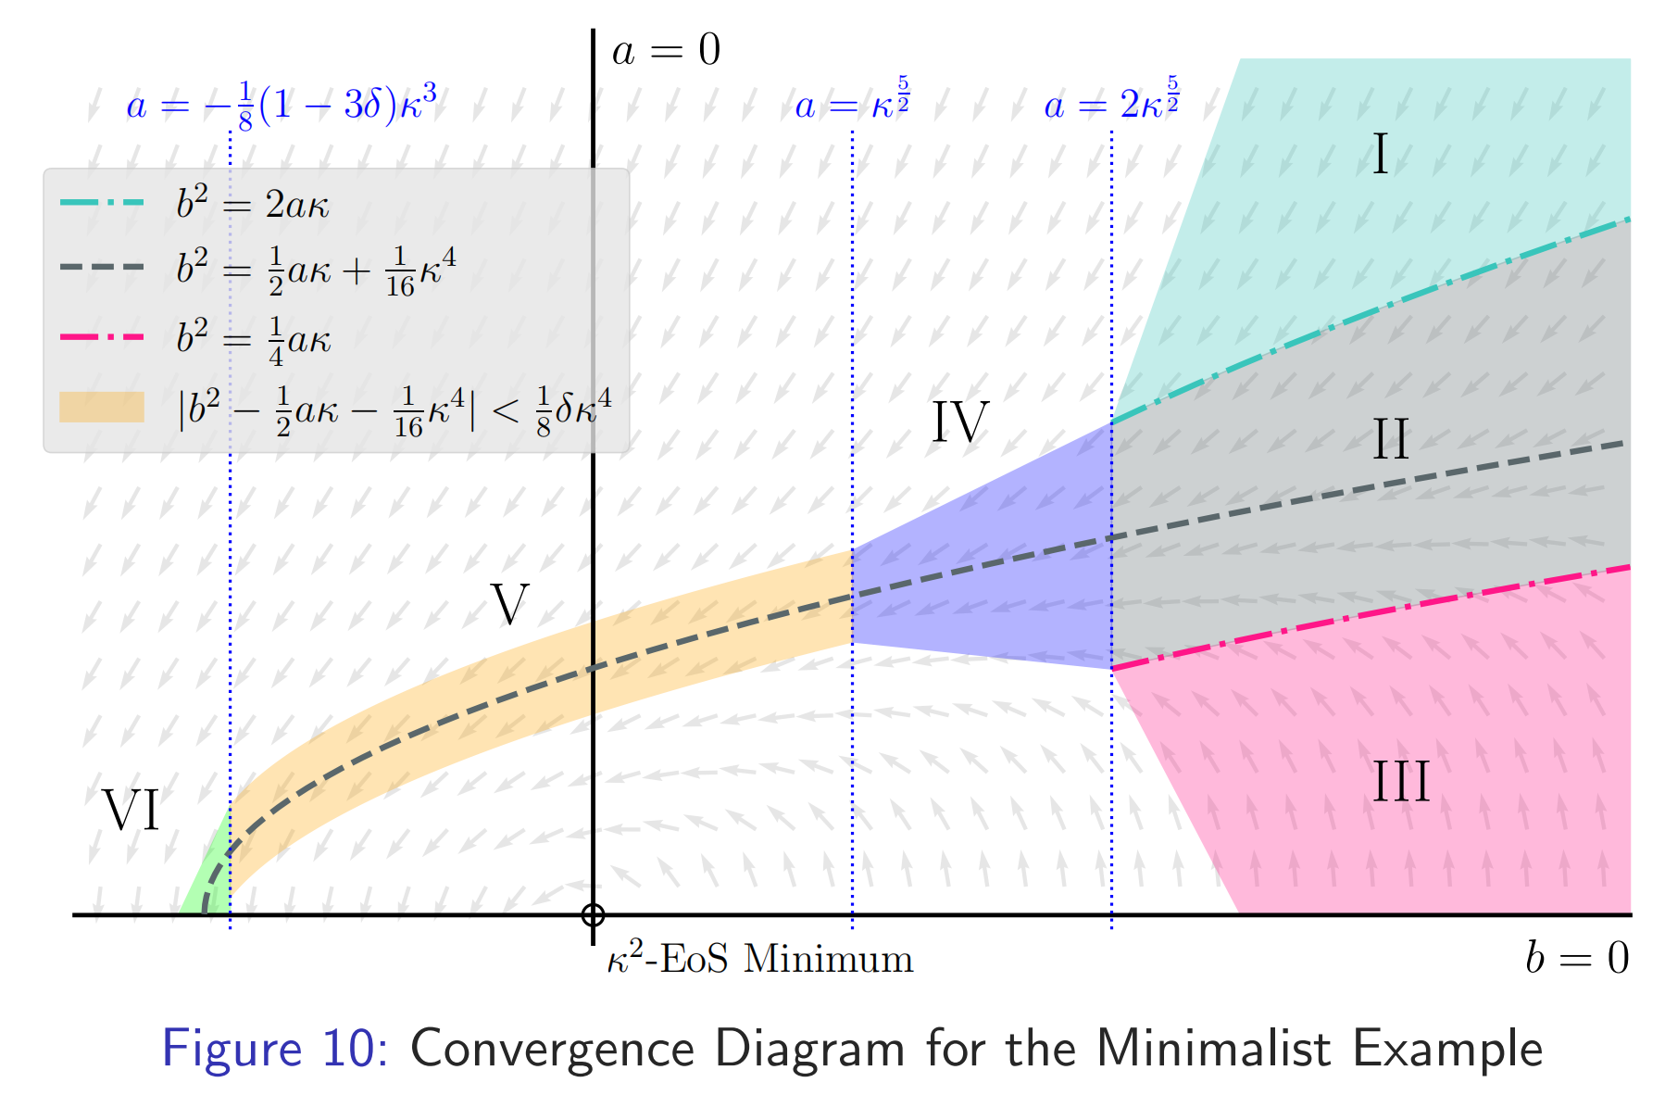
Fine-grained Analysis
Phase 1. (Convergence to near parabola)
Section I & III: soon enter section II
Section II: stay in this regime and eventually exit from the left
Phase 2. (Convergence along parabola)
After entering IV: provably converge to the parabola with O(κ⁴) error and enter section V.
Stay in V and finally converge in section VI to the vertex.
The vertex is not the exact η-EoS minimum (but close enough).

Slide 26
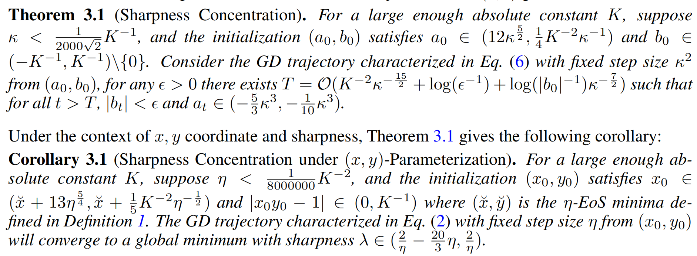
Provable Sharpness concentration
We prove the property with a constant size initialization region.

Slide 27
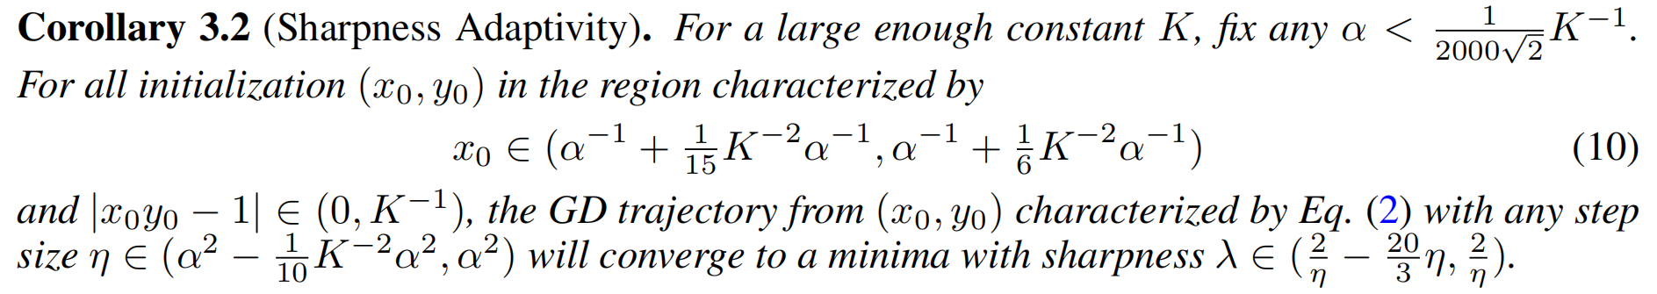
Provable Sharpness adaptivity
Since we have a large region of init, we can easily re-formalize the theorem for sharpness adaptivity.

Slide 28
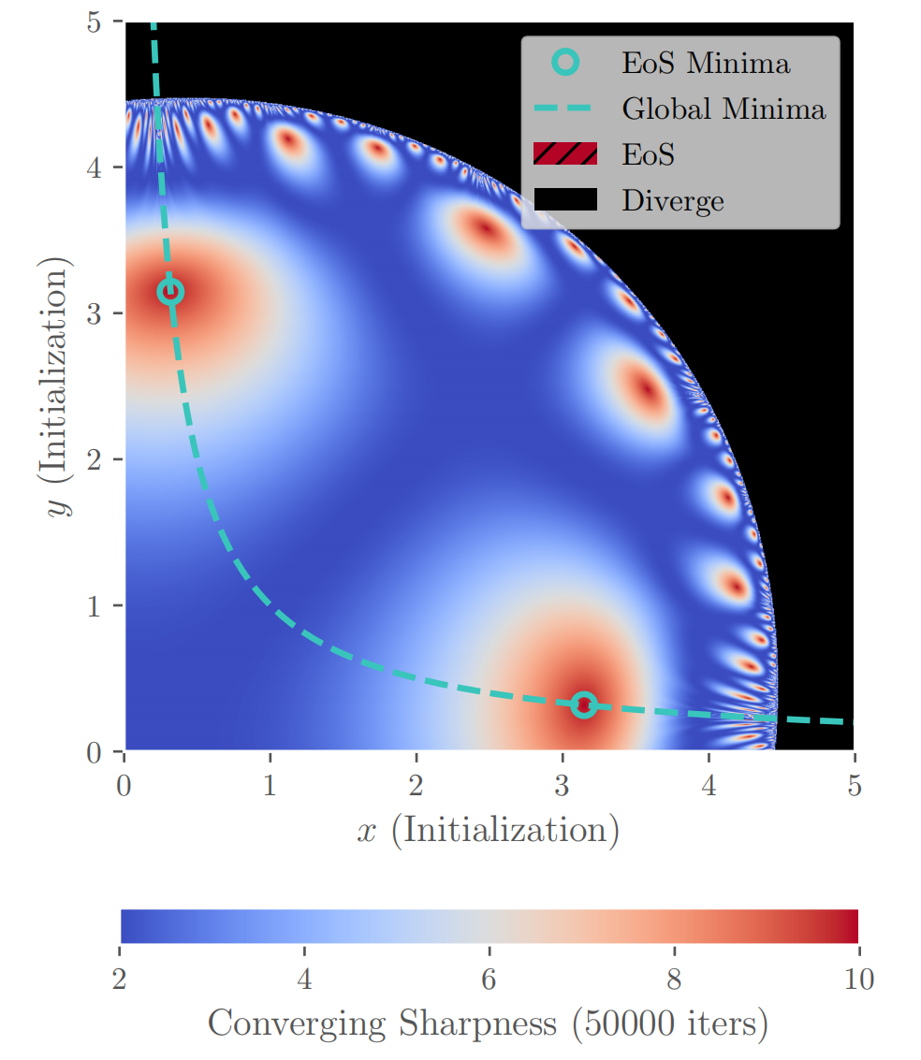
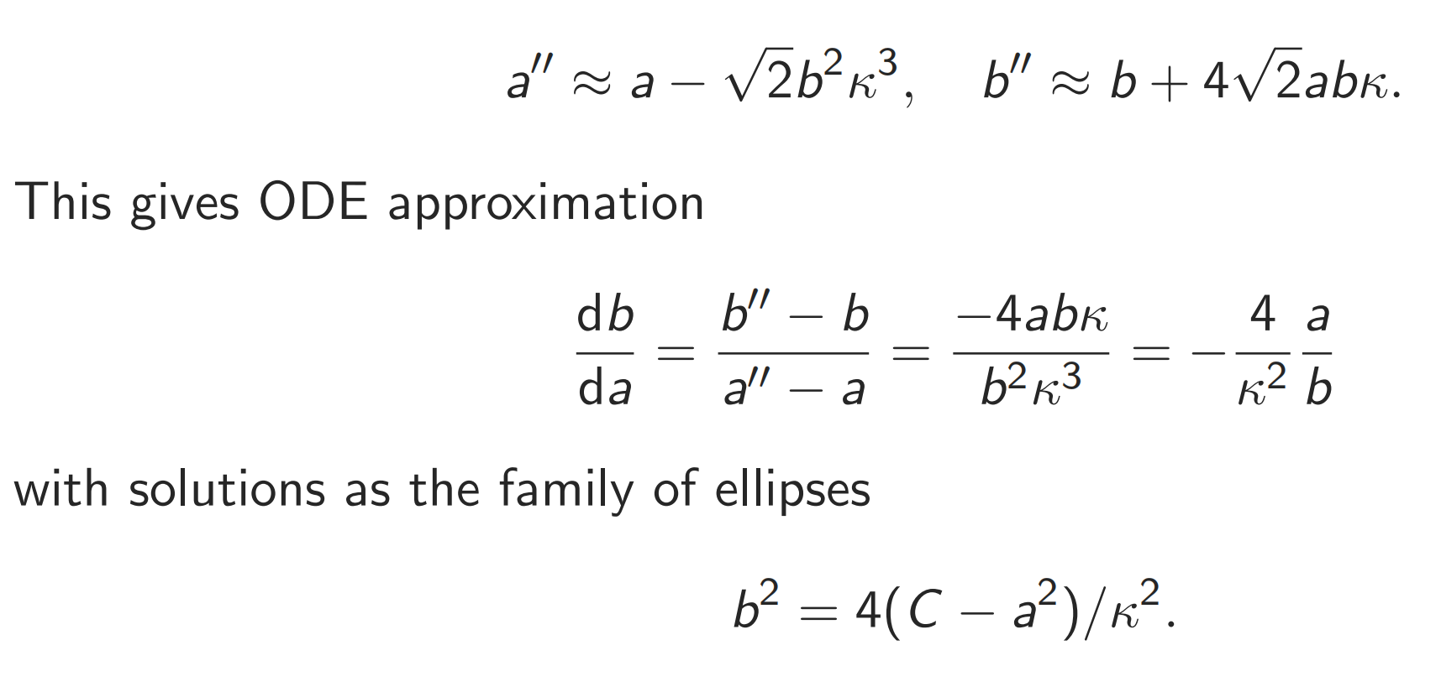
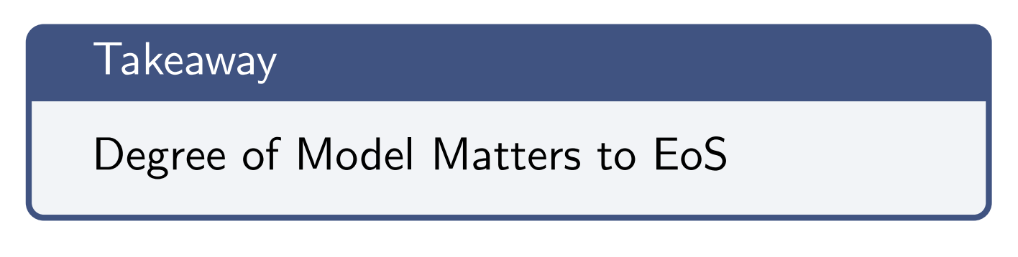
2-scalar case: why there is no EoS?
Similarly, we consider the 2-step dynamics:

Slide 29
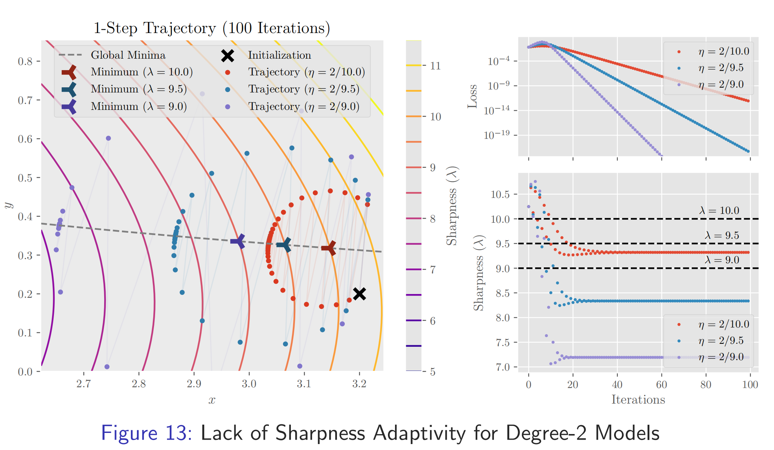
Difference Between Degree-2 and Degree-4 Models

Slide 30
Outline
Gradient descent, L-smoothness and sharpness
The Edge-of-Stability phenomenon
Our minimalist model with EoS + Trajectory analysis
Experiments + Discussions

Slide 31
Beyond Minimalist: real-world model
Critics: the model is too simple!
Not relevant to real-world problems!
Rejection!
Indeed, the analysis for real-world model is too hard…
Higher dimension models definitely have different characteristics.
But experiments show in some cases, our intuition also works on real world models!
Over-parameterized FC networks

Slide 32
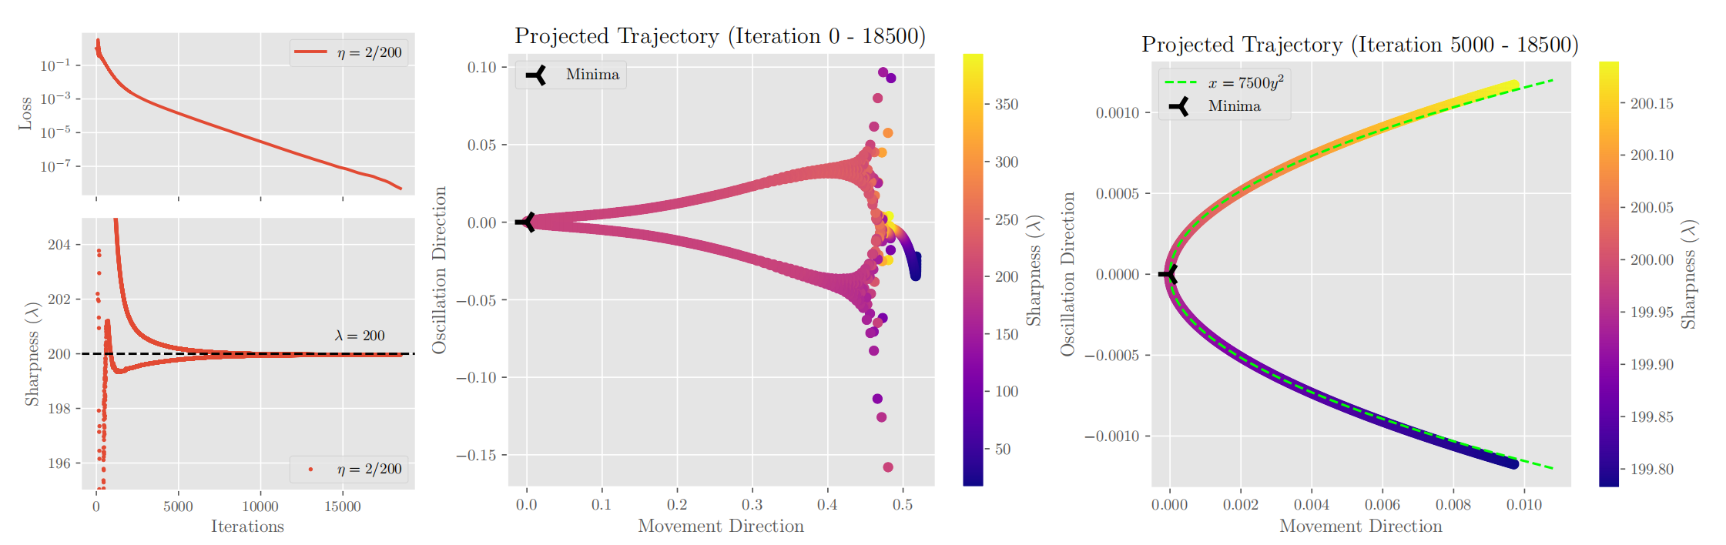
Beyond Minimalist: real-world model
Dataset: 50-image binary subset of CIFAR-10: cars (-1) & planes (+1)
Model: 5-layer ELU/tanh-activated fully-connected network; MSE loss
Parabolic trajectory on 2D subspace toward end of convergence

Slide 33
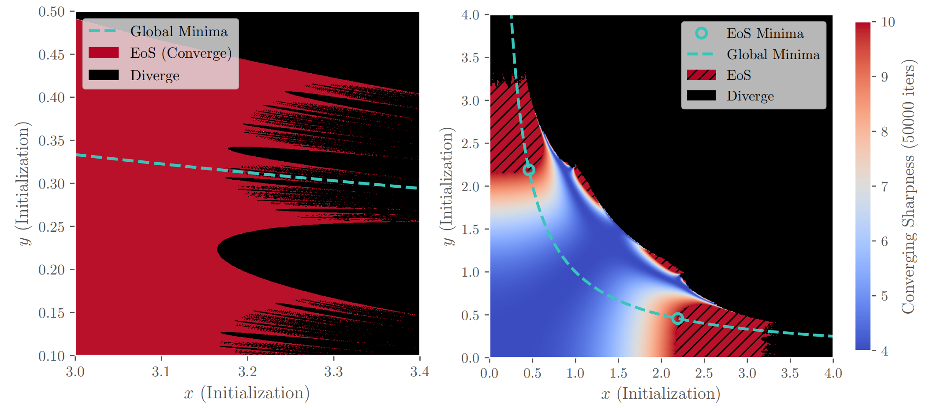
Global trajectory and chaos
Critics: Even though the init region is large, it’s still very local!
Yes…Even for the minimalist model, proving global convergence is intrinsically difficult!
Fractal Structures exists. No closed form for the boundaries

Slide 34
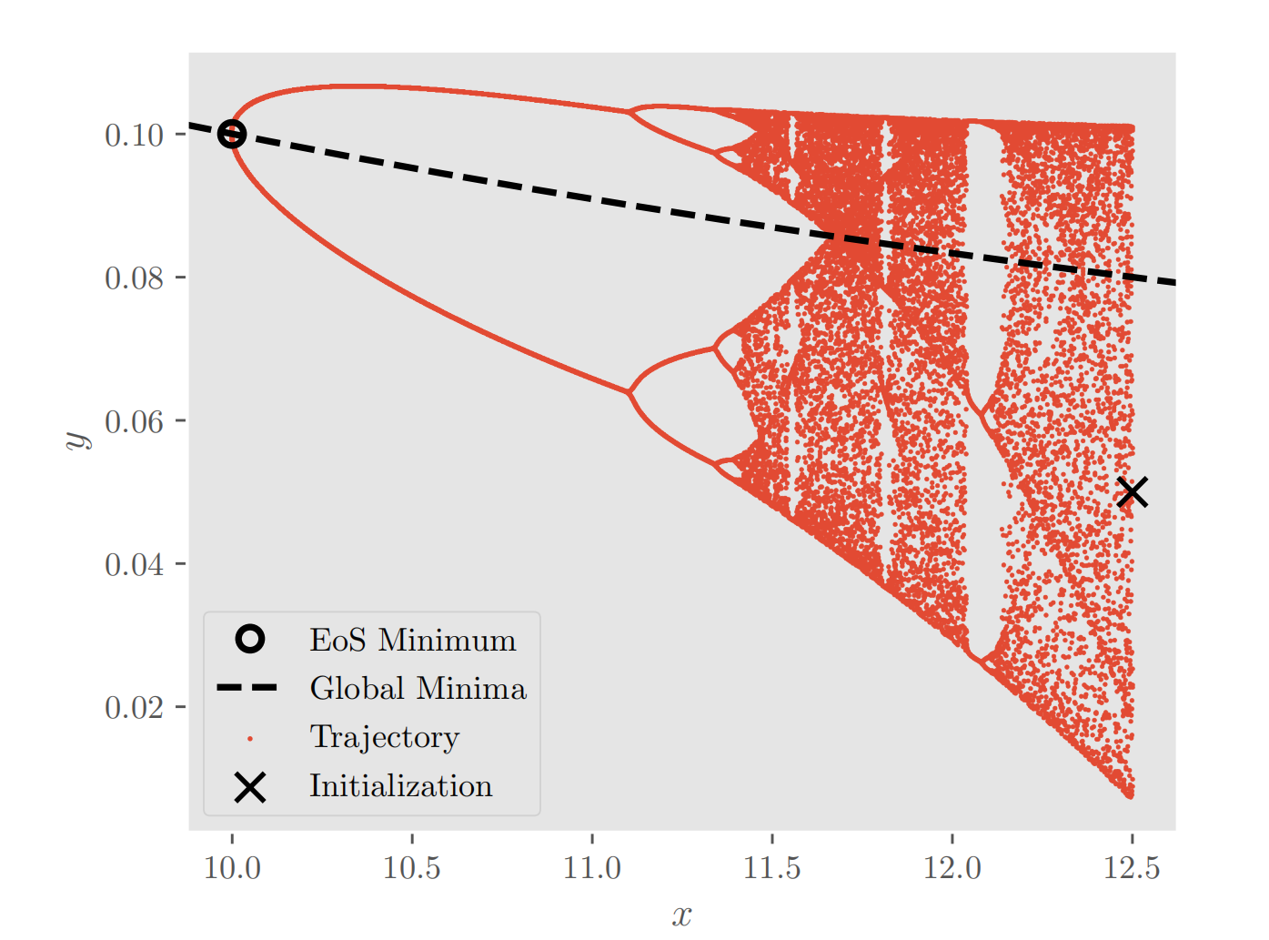
Bifurcation in GD dynamics
Near the boundary of convergence, the GD trajectory exhibits bifurcation.

Slide 35
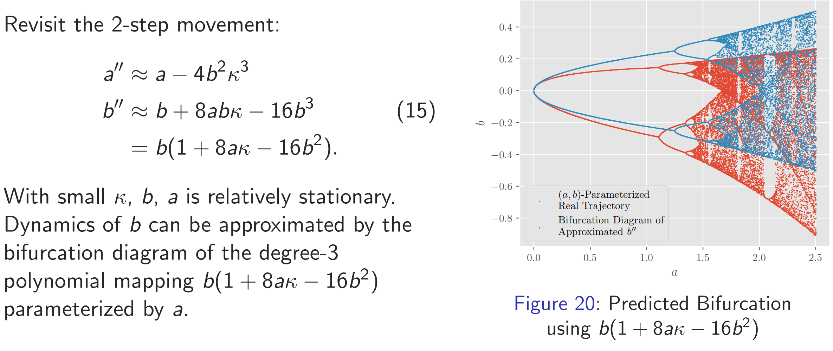
Source of Bifurcation

Slide 36
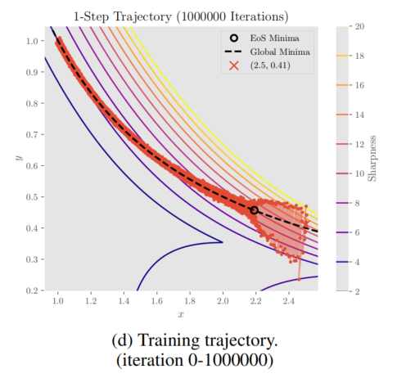
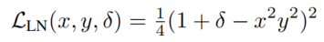
What about SGD?
So far we have focus on the GD dynamics.
What about the more general SGD? Does it exhibit EoS?
Yes. (But has other effects afterwards)
Consider our model with label noise:
First exhibits parabolic trajectory;
Then follows sharpness reduction flow
(Li et al., ICLR 2022)

Slide 37
Future Directions
Identify the source of EoS in general neural networks.
Find the boundary of bifurcation map on global convergence analysis.
Study EoS in stochastic gradient descent.

Slide 38
Acknowledgement
This work is completed under the supervision of Professor Rong Ge in collaboration with Xingyu Zhu, Xiang Wang Ph.D., and Mo Zhou.
I would like to thank Professor Rong Ge for the mentorship over my research experience in the Department of Computer Science at Duke University.
Thank Xingyu Zhu for helping me with this seminar by providing his graduate thesis presentation slides!

Slide 39
Thank you! Any questions?

